Slide 1
Greener and Cleaner Community
Final Report
Alan Zhou

Slide 2
Project Outline
Objectives: To clean up community + educate people on the negative effects of littering
-Led 3 sessions of garbage pick-ups with help from youth volunteers to clean up community
-Collected data during walks (what kind, where)
-Used the data to create a final poster showing my findings and why littering is harmful

Slide 3
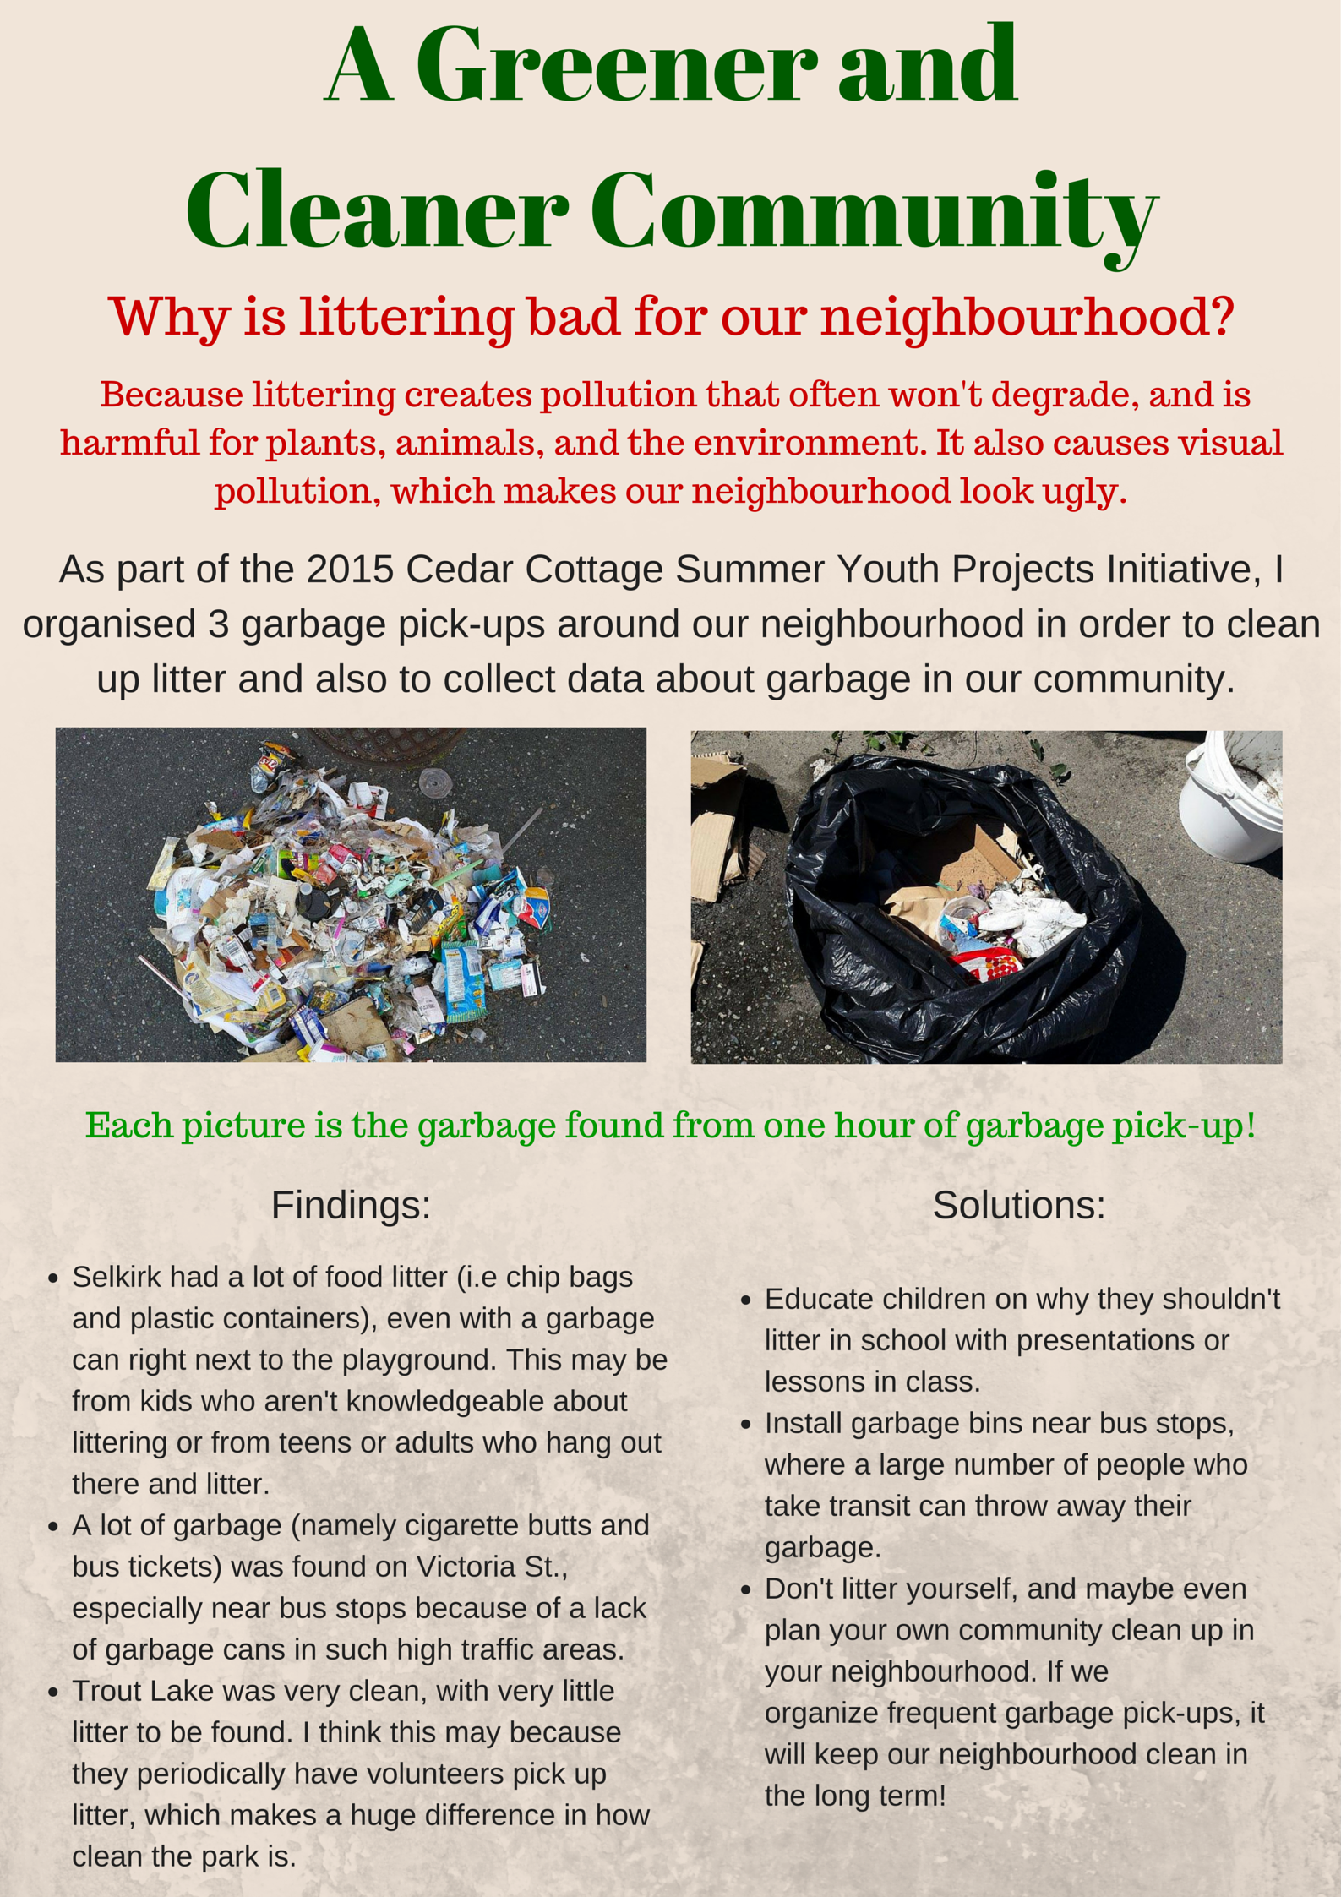
My final poster showing my findings and potential solutions

Slide 4
Self Evaluation
-Overall, I feel that my project turned out pretty well, my objectives were met and my project had a positive effect on the community.
-Looking back, I could have advertised more to reach out to more people

Slide 5
Process
-Sessions ran fairly smoothly, we picked up lots of garbage and I recorded detailed findings
-One problem I encountered was finding volunteers, I responded by asking many of my friends to help, and by adjusting what the timing of my sessions to last longer

Slide 6
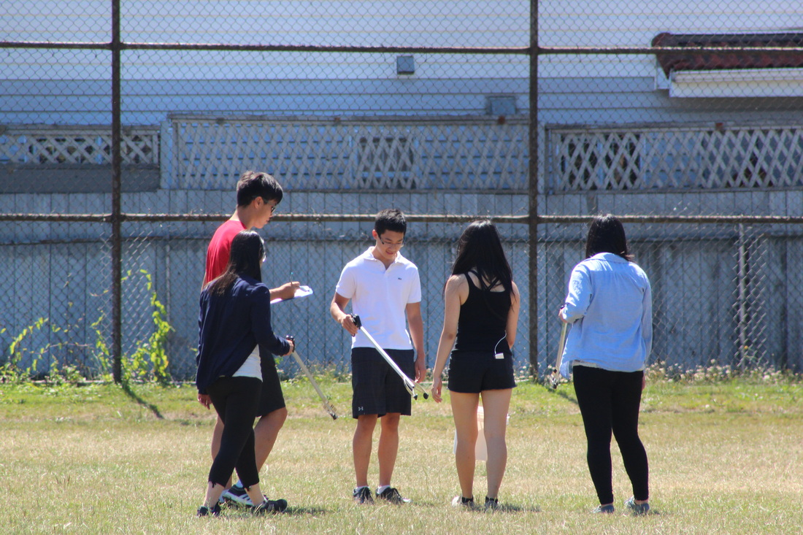
Process (continued)
-Reached target audience (youth) to help pick up garbage, small # of volunteers was ok
-Participants seemed to have fun during the sessions!

Slide 7
Outcomes
-Participants learned why we were doing garbage pick ups, and also the negative implications of littering
-Lots of garbage was picked up!

Slide 8
Outcomes (continued)
-Met my two project goals of making our community cleaner + educating people on implications of littering
-Short term outcomes: Neighbourhood is cleaner for now
-Long term outcomes: There will be less litter, and people will take initiative themselves and plan their own garbage pick-ups

Slide 9
Lessons Learned
-I learned how difficult it would be find volunteers for my sessions, would have advertised earlier and put more posters up
-I could have had more sessions to clean up more of the neighbourhood
-I learned how important it is to follow a structured plan, and to prepare for risks

Slide 10
Lessons Learned (continued)
-How supportive CCNH is, especially the staff!
- My strengths were that I was comfortable speaking to groups (during my sessions), but I was nervous speaking to people directly to ask for things (for supplies, to put up posters)

Slide 11
Future Role at CCNH
-Put up final versions of posters to educate people on littering
-Hold more community clean-ups in the future periodically to keep the neighbourhood clean!

