Slide 1
EULLY AO AND JUDY GONG

Slide 2
Objectives: Participants and Volunteers
Have fun in a safe environment
Demonstrate:
Creativity
Leadership
Problem solving
Teamwork
Explore + become familiar with neighbourhood
Cooperate + meet and build connections with new people
Improve communication
Unique experience

Slide 3
Outcomes
People really enjoyed the race
Sense of unity through working together
Everyone who was involved from us, to volunteers, to participants
A sense of achievement and pride
Memorable experience for all
An event many would like the opportunity to experience again
People were able to have fun in a safe environment
Teams cooperated with each other, and used leadership, creativity, and applied problem solving skills in order to finish the race

Slide 4
Activities
Beginning: Volunteer and participant orientation
Teams follow variety of clues to locations
Teams complete challenges with an emphasis on teamwork
Blindfolded Water Balloon Hunt
Brain Teasers
Tower Building
Water Balloon Toss
Heads Up
Volunteers explain, lead and run challenges
End: Participants and volunteers enjoy refreshments, while talking to people they just met or became closer with. Volunteers also log their hours.

Slide 5
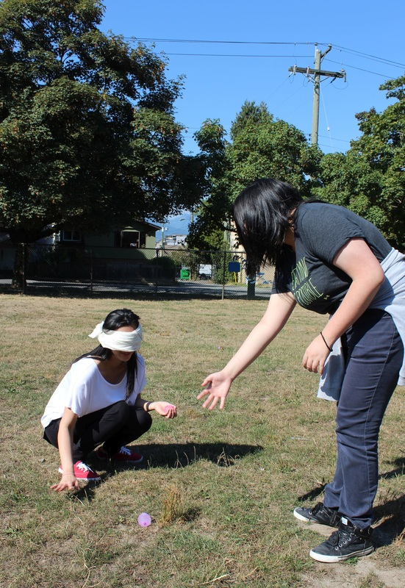
Event Photos
One teammate is guiding the other, who is blindfolded, verbally to pick up five water balloons at Selkirk Elementary.

Slide 6
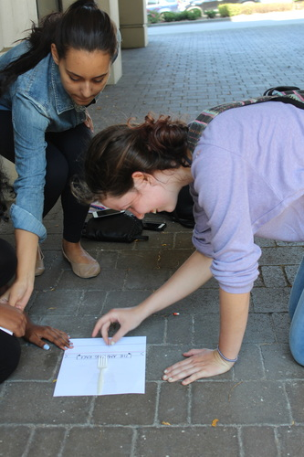
Event Photos
A participant is attempting to roll a coin into the spaces between a fork outside of Kensington Library.

Slide 7
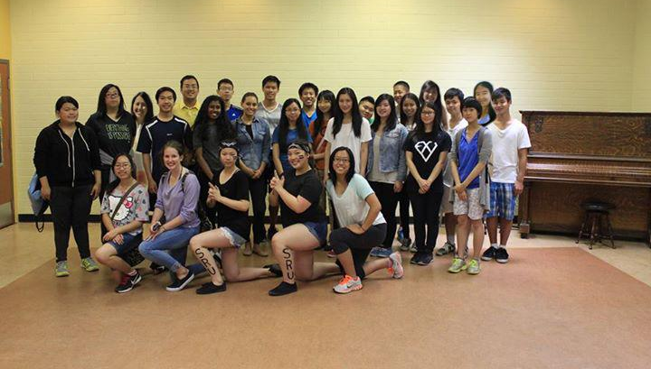
Event Photos
: Group Photo!

Slide 8
Self Evaluation
From the beginning, we had a clear image of what we would like this race to be and we knew what we needed to do in order for the vision to become reality
However, we did not realize how much time was actually needed to check each thing off our to do list, but we learned that a lot of time and effort needed to be put into every aspect in order for the event to go well
For example, we set aside an hour to make the clues, but clue making actually took an entire afternoon
We also did not realize how important it was to gather materials and promote as soon as we finished the poster, but we learned that doing so was essential in order to reduce the amount of work we had to do in the days before the event in case anything unexpected popped up creating more work
By working together as a team, we were still able to pull off an event that we are proud of despite the challenges we faced, and we learned from our mistakes and will apply our newfound knowledge to future experiences

Slide 9
Project Evaluation - Process
Some things did not go as planned
Refreshments were not made in time
Misjudged time = yogurt not frozen
Result: Ate the yogurt as yogurt - not a problem
Forgot to make lemonade, later no supervision
Result: Had water instead to accompany the cookies
Activities
Some teams found loopholes in our instructions
Result: Teams accused each other of cheating, however, it was done jokingly and there were no hard feelings. Also, the things they did were not exactly against the rules, so technically, they did not cheat.
At one station, two activities had to be completed but teams were given a choice of doing one or the other
Result: Less time needed to complete the station, so the race itself was shorter. This wasn’t a big problem - more time to clean up!
Notes:
· Were the activities performed as planned? If not, what went wrong and how did you respond? Be specific.
· Did the project reach its intended target population?
· How satisfied were the participants with their involvement?
· How should the promotion, planning and activities be modified to work better?

Slide 10
Project Evaluation - Process
Some things did not go as planned
Schedule
We started the race earlier because we finished explaining everything and participants were eager to begin
Result: Poor Randy was not notified and was not ready to go with them.
First placed team returned quicker than we anticipated so we had not set out the refreshments yet
Result: We set out the refreshments as people came in instead of having them all out before the teams came in. This wasn’t too much of a problem either, for putting out the food did not take long.
All teams finished quicker than expected, but this was good!
Result: More time for volunteers to record their hours and for us to clean up!
Notes:
Were the activities performed as planned? If not, what went wrong and how did you respond? Be specific.
· Did the project reach its intended target population?

Slide 11
Project Evaluation - Process
Reached intended target population
New and current youth volunteers for CCNH
Youth from our neighbourhood and school
Even reached youth from different neighbourhoods and schools
Some of our friends who did not enjoy events like these participated and tried new things in the process!
Notes:
· Were the activities performed as planned? If not, what went wrong and how did you respond? Be specific.
· Did the project reach its intended target population?
· How satisfied were the participants with their involvement?
· How should the promotion, planning and activities be modified to work better?

Slide 12
Project Evaluation - Process
Participants were satisfied
Had a lot of fun
Learned the importance of teamwork
Wanted to do the race again
Volunteers were enthusiastic about their stations and had a great time running the challenges
Notes:
· Were the activities performed as planned? If not, what went wrong and how did you respond? Be specific.
· Did the project reach its intended target population?
· How satisfied were the participants with their involvement?
· How should the promotion, planning and activities be modified to work better?

Slide 13
Project Evaluation - Process
Modifications
Promote in areas with lots of youth (eg. summer school, Facebook grade group, community centres)
Set sign-up deadline so that we aren’t scrambling to adjust the materials to fit the number of participants last minute
Gather supplies earlier
Make more difficult challenges so the race would a little take longer and participants can have a more enriching experience
Have extra supplies at each station in case something happens (eg. scissors getting stuck)
Notes:
· Were the activities performed as planned? If not, what went wrong and how did you respond? Be specific.
· Did the project reach its intended target population?
· How satisfied were the participants with their involvement?
· How should the promotion, planning and activities be modified to work better?

Slide 14
Outcomes: Change in Participants
Understood that learning about leadership and teamwork can be fun and that these skills can be obtained, improved on, and applied to a variety of situations in the future
Understood that there are more ways to learn other than in school and from a textbook
Notes:
· Did the participants experience any changes in their skills, knowledge or behaviours? What changes were expected? Were they realistic?
· What are the effects of the project on my partnering organization, if any? (CCNH)
· Did the project meet the needs/objectives that led to your creation of the project?
· What could be the short-term and long-term impacts of this project?

Slide 15
Outcomes: Effects on CCNH
Strengthened youth involvement
New volunteers
More youth now know about CCNH
Spread the word to their friends about this event and Cedar Cottage
More likely to be involved with CCNH in the future
Notes:
· Did the participants experience any changes in their skills, knowledge or behaviours? What changes were expected? Were they realistic?
· What are the effects of the project on my partnering organization, if any? (CCNH)
· Did the project meet the needs/objectives that led to your creation of the project?
· What could be the short-term and long-term impacts of this project?

Slide 16
Outcomes: Needs and Objectives
Expected that the objectives will be met
Objectives were met
Teams cooperated with each other
Participants used communication, leadership, creativity, and applied problem solving skills in order to finish the race
Participants had a fun and unique experience exploring the neighbourhood
Notes:
· Did the participants experience any changes in their skills, knowledge or behaviours? What changes were expected? Were they realistic?
· What are the effects of the project on my partnering organization, if any? (CCNH)
· Did the project meet the needs/objectives that led to your creation of the project?
· What could be the short-term and long-term impacts of this project?

Slide 17
Outcomes: Impact
Short-term
People had a great day!
Long-term
New volunteers for CCNH = increased community involvement
Increased appreciation for teamwork
Participants and volunteers improve on valuable skills for life
Notes:
· Did the participants experience any changes in their skills, knowledge or behaviours? What changes were expected? Were they realistic?
· What are the effects of the project on my partnering organization, if any? (CCNH)
· Did the project meet the needs/objectives that led to your creation of the project?
· What could be the short-term and long-term impacts of this project?

Slide 18
Project Promotion
Changes to make
Promote the event once we have the date and time
Use posters more effectively, and place them in more strategic locations
We put up posters at Trout Lake Community Centre and Kensington Library, however, it was through word of mouth that got us all the volunteers and participants
Incorporate other forms of promotion, such as social media
Notes:
· What could have been done differently to promote and complete my project?
· What key changes would I make to enhance the success of my objectives?
· What skills/knowledge did I learn in the process and the activities?
· What lessons did I learn about working with an organization like CCNH?
· What did I learn about CCNH as an organization?
· What were your strengths, and how did you challenge yourself?

Slide 19
Project Completion
Changes to make
Complete tasks assigned for the week, don’t push them back because that leads to doing too many things in the last week and increased stress
Clearer instructions for volunteers, as well as rules for challenges to ensure that the activities run the way we want them to
Ask for permission before going ahead with something
Stations: The librarian was fine with us using the library as a station, however the library is closed on Mondays so we had to come up with a new challenge
Front Desk Sign-ups: We had already put on the posters that people could sign up at the CCNH front desk, however, we were actually unable to because the front desk is not responsible for any sign ups.

Slide 20
Key Changes To Enhance Success
Be prepared for anything that could go wrong
Plan well ahead and make deadlines (eg. people signing up the day before event)
Manage time more wisely, leave more than enough time to finish a task so we would not have to rush anything
Develop harder activities that require a deeper level of critical thinking, teamwork and leadership so participants can further expand on such skills
Notes:
· What could have been done differently to promote and complete my project?
· What key changes would I make to enhance the success of my objectives?
· What skills/knowledge did I learn in the process and the activities?
· What lessons did I learn about working with an organization like CCNH?
· What did I learn about CCNH as an organization?
· What were your strengths, and how did you challenge yourself?

Slide 21
New Skills and Knowledge
Risk management
Contact numbers should any problems arise (proved to be essential)
Limiting safety hazards
Time management
Takes a great deal of time and effort to host an event
Set deadlines and do not try to do too much at once
Event organization
Problem solving and critical thinking when dealing with unexpected issues during the event
Gain a better understanding of each stage of running an event
Developing ideas, creating plans, advertising, material gathering, scheduling, organizing volunteers, hosting, clean up
Notes:
· What could have been done differently to promote and complete my project?
· What key changes would I make to enhance the success of my objectives?
· What skills/knowledge did I learn in the process and the activities?
· What lessons did I learn about working with an organization like CCNH?
· What did I learn about CCNH as an organization?
· What were your strengths, and how did you challenge yourself?

Slide 22
Working with CCNH
Although we are the ones who ran and planned the race, we had to cooperate with CCNH in many different aspects
Volunteers must submit forms to volunteer for CCNH
Always have to ask the right person to borrow supplies
CCNH follows the Good Food Principles
Our refreshments had to meet those guidelines
Yogurt with higher nutritional value as opposed to freezies, which are not healthy
They were friendly, helpful and supportive
Notes:
· What could have been done differently to promote and complete my project?
· What key changes would I make to enhance the success of my objectives?
· What skills/knowledge did I learn in the process and the activities?
· What lessons did I learn about working with an organization like CCNH?
· What did I learn about CCNH as an organization?
· What were your strengths, and how did you challenge yourself?

Slide 23
Our Strengths and Challenges
Strengths
We had a clear vision of the event, because we knew from the beginning what tasks were needed to be accomplished in order to run the event, resulting in a smooth planning process
Challenges
Managing and allotting time, figuring out how much time is needed to complete each task
Budgeting
We had to buy refreshments, materials, and prizes, but in the end, we stayed within our budget!
Recruiting participants
Initially, very few people wanted to participate in the race, so we reached out to all our friends, who in turn reached out to theirs
Notes:
· What could have been done differently to promote and complete my project?
· What key changes would I make to enhance the success of my objectives?
· What skills/knowledge did I learn in the process and the activities?
· What lessons did I learn about working with an organization like CCNH?
· What did I learn about CCNH as an organization?
· What were your strengths, and how did you challenge yourself?

Slide 24
Future Role at CCNH
Volunteer for more programs
Take on more of a leadership role in the programs we volunteer for
Encourage youth to use skills they learned
Host another Amazing Race?

Slide 25
Huge thank you to Randy, CCNH, and all the volunteers and participants!

